Slide 1

1 - 4 June 2016 ● Split, Croatia

Slide 2
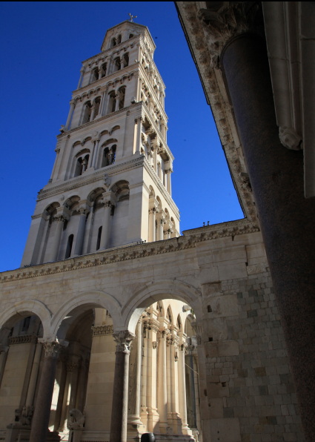
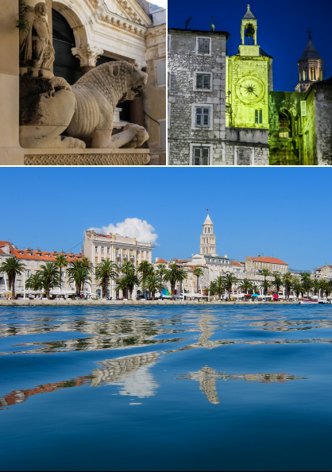
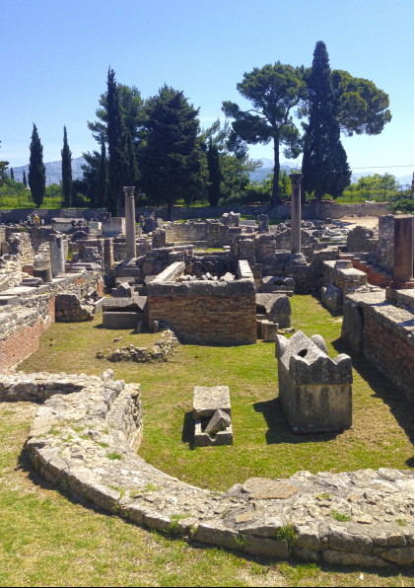


Slide 3
The President of the Republic of Croatia, Mrs. Kolinda Grabar-Kitarović
Split-Dalmatia County
City of Split
University of Osijek
University of Rijeka
University of Split
University of Zagreb

Slide 4
Zrinka Kovarik, Chair
Jerka Dumić
Damjan Franjević
Hrvoje Fulgosi
Ljubica Glavaš-Obrovac
Maja Herak Bosnar
Maja Pavela Vrančič
Jadranka Varljen
Irena Drmić Hofman, Chair
Maja Katalinić, Secretary
Ljubica Glavaš-Obrovac, Treasurer
Tihomir Balog
Viljemka Bučević-Popović
Vedrana Čikeš-Čulić
Anita Markotić
Angela Mastelić
Ivana Novak Nakir
Stjepan Orhanović
Mila Radan
Nikolina Režić Mužinić
Jasmina Rokov Plavec

Slide 5







Slide 6
1 - 4 June 2016 ● Split, Croatia

Slide 7
The Foundation of the Croatian Academy of Science and Arts
FEBS - Federation of European Biochemical Societies
IUBMB - International Union of Biochemistry and Molecular Biology
Institute for Medical Research and Occupational Health, Zagreb
Josip Juraj Strossmayer University of Osijek, School of Medicine
Ruđer Bošković Institute, Zagreb
Split-Dalmatia County
Tourist Board of Split
City of Split
University of Split
University of Split, Faculty of Chemistry and Technology
University of Split, School of Medicine
University of Zagreb, Faculty of Pharmacy and Biochemistry
University of Zagreb, Faculty of Science, Department of Biology
University of Zagreb, Faculty of Science, Department of Chemistry

Slide 8
























Slide 9










Slide 10
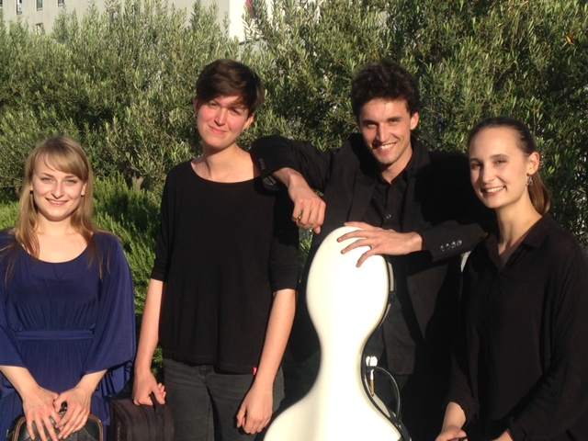
String Quartet of the Academy of Arts Split
Schostakovich String Quartet no.1 . 1st movement

Slide 11
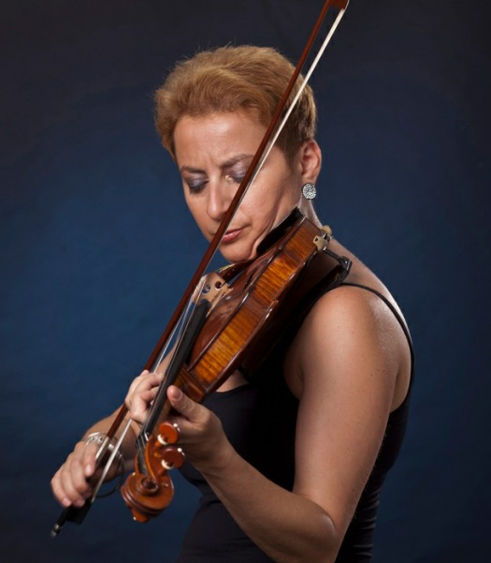
Evgenia Epshtein,
Academy of Arts, University of Split
Brahms sonata n.2, 1st movement
Joseph Suk: Appasionato
Piano by Marina Ivanova

